Slide 1
'Reduce spaghetti <pre>code</pre>' with 'functional' + async + ' flows ' => using ('RxJS')
const by = {
name : 'Luis Atencio',
twit : '@luijar',
site : 'luisatencio.net',
work : 'Citrix Systems'
};

Slide 2


About me
Cloud Engineer @ Citrix
10+ years writing applications in PHP, JavaScript, and Java
Author
Speaker

Slide 3

I’m going to be dad!

Slide 4
What is Reactive Programming?
!Platform && !Library && !Framework
!Technique && !Design Pattern
!Language
Paradigm oriented around
Data flows + Propagation of change

Slide 5
Reactive Manifesto

Slide 6
New way of thinking
var A = 40;
var B = 2;
var C = A + B; //-> 42
A = 100;
C = ?

Slide 7
New way of thinking₂
var A$ = 40;
var B$ = 2;
var C$ = A$ + B$; //-> 42
A$ = 100;
C$ = ;
102

Slide 8
Companies using RxJS

Slide 9
Why?
Most of the code we write is asynchronous!!!
Reduce complexity
Create code that is easier to trace, debug, and test
Achieve modularity
Avoid duplications
Create code that is extensible and configurable

Slide 10
Typical async calls look like this...
makeAsyncHttpCall('/data', data => {
for (let item of data) {
// process each item
}
});

Slide 11
Then they turn into...
makeAsyncHttpCall('<serv1>/data', data => {
for (let item of data) {
makeAsyncHttpCall(`<serv2>/data/${item.getId()}/info`,
dataInfo => {
makeAsyncHttpCall(`<serv3>/data/images/
${dataInfo.img}`,
image => {
// ... begin process
});
});
}
});

Slide 12
What is RxJS?
A reactive programming library for JS, based on the design of the Reactive Extensions (Rx)
Treats every source of data with the same computing model using the Observable: A Stream!
Designed to handle infinitely many values (events)
https://github.com/ReactiveX/rxjs

Slide 13
Is it important for JS devs?
Cycle.js
Redux middleware
Yolk.js
React.js
Angular 2
TC39 Observable spec ES7 (https://github.com/zenparsing/es-observable)

Slide 14
RxJS builds on the shoulders of
Notes:
Handle with the same elegance? Error handling tends to be very messy with try/catch statements

Slide 15
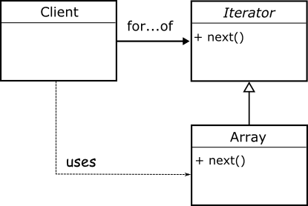
Iterators: data agnostic traversal

Slide 16
btw. ES6 has native iterators
var iter1 = ['B', 'o', 'c', 'a', 'J', 'S'][Symbol.iterator]();
iter1.next().value; // B
iter1.next().value; // o
iter1.next().value; // c
iter1.next().value; // a
var iter2 = 'Rocks'[Symbol.iterator]();
iter2.next().value// -> R
iter2.next().value// -> o

Slide 17
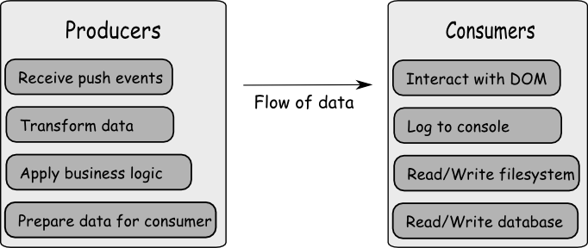
Observer: Producers + Consumers

Slide 18
Functional Programming
RxJS encourages you to use a functional style of development
Side effect free functions
Immutability
Singular, PURE functions
Flow of data
Function composition
Functors, Monads, and function chains

Slide 19
Functional programming: Functors
Functors give you the ability to lift a pure function into any context
Context.of('Hello')
.map(toUpper)
.map(concatWith('World'))
.map(repeat(2));
// -> HELLO WORLD HELLO WORLD

Slide 20
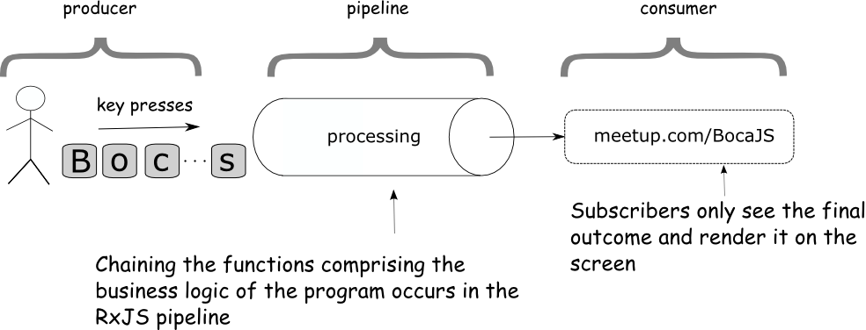
An RxJS stream is composed of
citrix.com
C
I
T
X
The Observable

Slide 21
An Observable
Represents sequences of events (values) over time
Asynchronous
Lazy
Repeatable, bufferable, pausable, filterable, mapable, etc-able, ...
They can be hot or cold

Slide 22
Hello to the World of streams
Producer
Rx.Observable.of('Hello', 'World', '!')
.map(toUpper)
.subscribe(console.log);
//-> HELLO WORLD !
Pipeline
Consumer

Slide 23
Producers
Notes:
Handle with the same elegance? Error handling tends to be very messy with try/catch statements

Slide 24
Producers: sources of data
RxJS unifies working with:
Strings & Numbers
Arrays
Promises
Generators
Callbacks
Event Emitters & DOM events
Web Sockets
Exceptions
Timers
... create your own

Slide 25
Creating Observables
Rx.Observable.of('a', 'b', 'c');
Rx.Observable.of(1, 2, 3);
Rx.Observable.of(['a', 'b', 'c']);
Rx.Observable.from(idGenerator());
Rx.Observable.fromPromise(
$.getJSON('https://api.github.com/users'));
Rx.Observable.fromEvent(button, 'click');
Works with pretty
much anything

Slide 26
Consumers
Notes:
Handle with the same elegance? Error handling tends to be very messy with try/catch statements

Slide 27
Consuming Observables
let subscription = Rx.Observable.subscribe(observer);
let subscription = Rx.Observable.forEach(observer);
//....
subscription.unsubscribe();

Slide 28
The Observer
var observer = {
next: function (val) {
// do something with result
},
error: function (msg) {
// alert user
},
complete: function () {
}
};

Slide 29
Pipeline
Notes:
Handle with the same elegance? Error handling tends to be very messy with try/catch statements

Slide 30
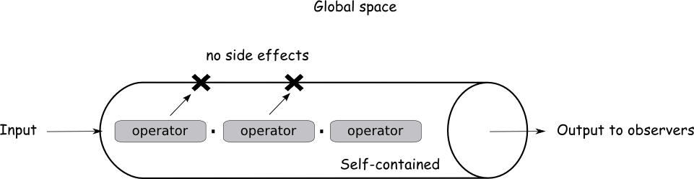
Pure pipeline

Slide 31
Familiar computing model
Make everything as easy as working with arrays (1 model for all)
Functions embedded into the pipeline contain the main business logic of your program
Array.of(data).map(func1).filter(func2).reduce(func3);

Slide 32
Easier to reason about async data
Rx.Observable.of(localArray)
.map(func1)
.filter(func2)
.take(3)
.forEach(console.log);
Rx.Observable.of(fetchAsyncData())
.map(func1)
.filter(func2)
.take(3)
.forEach(console.log);
Data comes in
sync
Data comes in
async
Notes:
Less array allocations, less intermediary arrays, less closures over functions, less GC

Slide 33
An optimized async-FP toolkit
Borrows the same FP approach of arrays, but a lot more optimized than LoDash and Underscore
Avoid creating temporary data structures
Additional set operators:
take = take x amount from infinitely many
concat = append two streams
merge = interleave streams
zip = interleave streams keeping position
skip = ignore events based on certain criteria
scan = like reduce, emit at each iteration
... many more
Notes:
Less array allocations, less intermediary arrays, less closures over functions, less GC
Observables pass each value through the pipeline, vs entire result

Slide 34
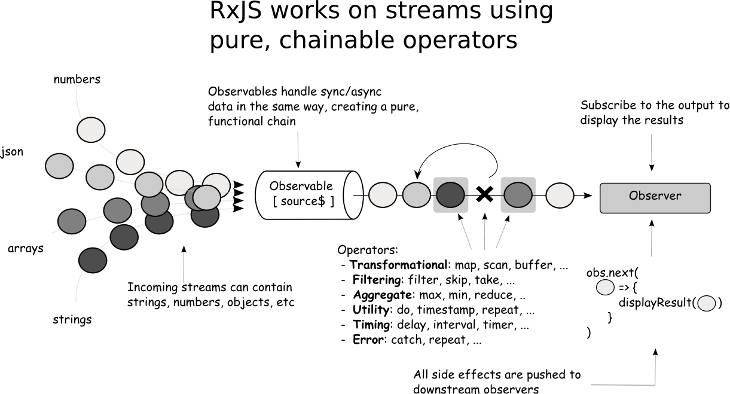
Notes:
Less array allocations, less intermediary arrays, less closures over functions, less GC
Observables pass each value through the pipeline, vs entire result

Slide 35
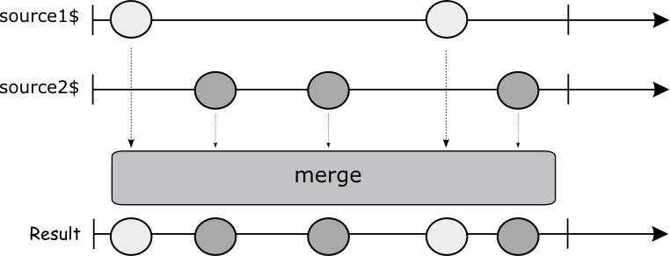
Visualizing operator mechanics: merge

Slide 37
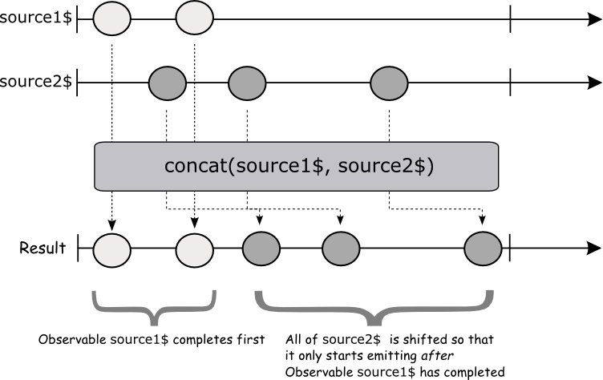
Visualizing operator mechanics: concat

Slide 38
Example
const genRandomNumber = (max) =>
Array.of(Math.random())
.map(x => max * x)
.map(Math.floor)
.reduce(x => x);
const randomNum$ = Rx.Observable.create(observer => {
const id = setInterval(() => {
observer.next(genRandomNumber(10));
}, 1000);
return () => {
clearInterval(id);
}
});

Slide 39
Example
const isEven = num => num % 2 === 0;
const add = (x, y) => x + y;
randomNum$
.filter(isEven)
.take(10)
.reduce(add, 0) // .scan(add, 0)
.subscribe(console.log);
Pipeline
(business logic)

Slide 40
Higher-order
Observables
Notes:
Handle with the same elegance? Error handling tends to be very messy with try/catch statements

Slide 41
Advanced operators
Equivalent stream combinators + flattening
Extremely useful to implement more advanced behavior and to join one stream to the next, or many async data streams:
mergeMap – projects each source value to another observable which is merged in the output
switchMap – like mergeMap, except emitting values only from most recently projected observable
concatMap – like mergeMap, but values emitted keep their order instead of being interleaved.
Notes:
Less array allocations, less intermediary arrays, less closures over functions, less GC

Slide 42
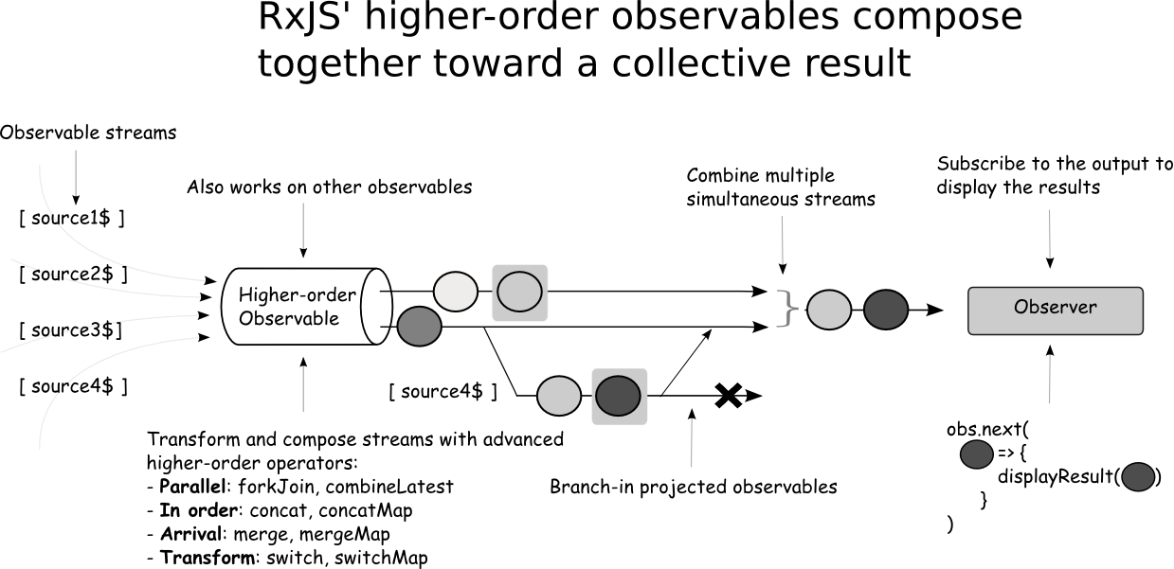
Notes:
Less array allocations, less intermediary arrays, less closures over functions, less GC
Observables pass each value through the pipeline, vs entire result

Slide 43
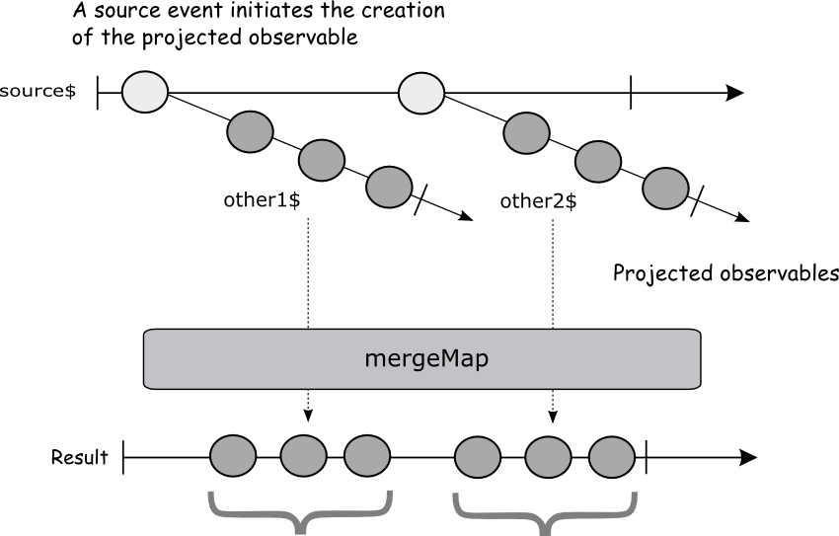
Marble diagram for mergeMap()

Slide 44
Finding 10 random cities in the world
const fetchPostalCode = postalCode => Rx.Observable.fromPromise($.get(`http://api.geonames.org/...`));
randomNum$
.bufferCount(5)
.map(arr => arr.join(''))
.do(code => console.log(`Looking up: ${code}...`))
.mergeMap(code => fetchPostalCode(code))
.map(xml => $(xml).find("name").text())
.filter(city => city.length > 0)
.take(10)
.subscribe(console.log);
Cache 5 numbers
Geocode
Find name
Keep valid
cities
//-> "Looking up: 41315..."
"Göteborg"
"Looking up: 03321..."
"Warszawa"
"Looking up: 45103..."
"Batavia"

Slide 45
Error Handling
“Reactive applications must always be responsive in the face of failure”
Notes:
Handle with the same elegance? Error handling tends to be very messy with try/catch statements

Slide 46
Error operators
Promises are not repeatable values, observables are
catch: catch and handle an error within a stream
throw: wrap an exception into an Observable
repeat: repeat the execution of an observable for any number of times
repeatWhen: repeat sequence when an observable emits a value, timers, exponential backoff, etc.
Notes:
Less array allocations, less intermediary arrays, less closures over functions, less GC

Slide 47
Adding error handling to our code
const fetchPostalCode = postalCode =>
Rx.Observable.fromPromise(
$.get(`http://api.geonames.org/...`))
.repeat(3)
.catch(err$ => Rx.Observable.throw('Service is down!'));
const subs = randomNum$
...
.subscribe(
city => console.log(city),
error => console.log('Error detected: ' + error)
);

Slide 48
Time
Notes:
Handle with the same elegance? Error handling tends to be very messy with try/catch statements

Slide 49
RxJS makes time a first-class citizen
interval: emits values at set interval (setInterval)
timer: emit a value after time elapsed (setTimeout)
debounceTime: emit values only after a certain time span has passed without another emission
throttle: emits a value, then ignores subsequent values for a duration determined by another observable
Notes:
Throttling enforces a maximum number of times a function can be called over time. As in "execute this function at most once every 100 milliseconds."
Debouncing enforces that a function not be called again until a certain amount of time has passed without it being called. As in "execute this function only if 100 milliseconds have passed without it being called."

Slide 50
Cancelling
Notes:
Handle with the same elegance? Error handling tends to be very messy with try/catch statements

Slide 51
Observables are cancelable
const randomNum$ = Rx.Observable.create(observer => {
const id = setInterval(() => {
observer.next(genRandomNumber());
}, 500);
return () => {
clearInterval(id);
};
});
// some time later
setTimeout(() => {
sub.unsubscribe();
}, 10000);
Hard to achieve with
native JS event
system

Slide 52
“LoDash (or Underscore) for async”
Notes:
Handle with the same elegance? Error handling tends to be very messy with try/catch statements

Slide 53
“Any number of things, for any number of time ”
-Ben Lesh
Notes:
Handle with the same elegance? Error handling tends to be very messy with try/catch statements

Slide 54
What’s new in RxJS 5?
Re-written from the ground, up TS -> JS
Faster core
Optimized use of closures
Class-based operators (lift)
Simplified error handling
Reduced set of APIs
Modularity
Better unit tests
Conformant with ES7 Observable spec

Slide 55
Important topics not covered in this talk
Schedulers
Hot vs Cold observables
Back-pressure

Slide 56
Cool resources
Which operator to use?
https://github.com/Reactive-Extensions/RxJS/blob/master/doc/gettingstarted/which-instance.md
Rx Marbles
http://rxmarbles.com/
Rx
https://github.com/ReactiveX

Slide 57
Tutorials
http://bit.ly/sunshine-warm1

Slide 58
Tutorials
http://bit.ly/sunshine-warm2

Slide 59
Tutorials
http://bit.ly/sunshine-warm3

Slide 60
Tutorials
http://bit.ly/sunshine-rx1

Slide 61
Tutorials
http://bit.ly/sunshine-rx2

Slide 62
Tutorials
http://bit.ly/sunshine-rx3

Slide 63
Tutorials
http://bit.ly/sunshine-rx4

Slide 64
Final
http://bit.ly/sunshine-calc

Slide 65
Tutorials

Slide 66
Solutions
Calculator
http://jsbin.com/dizike/18/edit?js,output
Search
http://jsbin.com/rugowa/edit?js,output
Drag and Drop
http://jsbin.com/dogino/edit?js,output
Progress bar
http://jsbin.com/xohipa/edit?js,output

Slide 67

RxJS in Action
http://bit.ly/rxjsinaction
Discount code: 39daniels

Slide 68
Functional
Programming in
JavaScript
http://bit.ly/functional-js-book
Order in Amazon!
Discount code: 39atencio

Slide 69
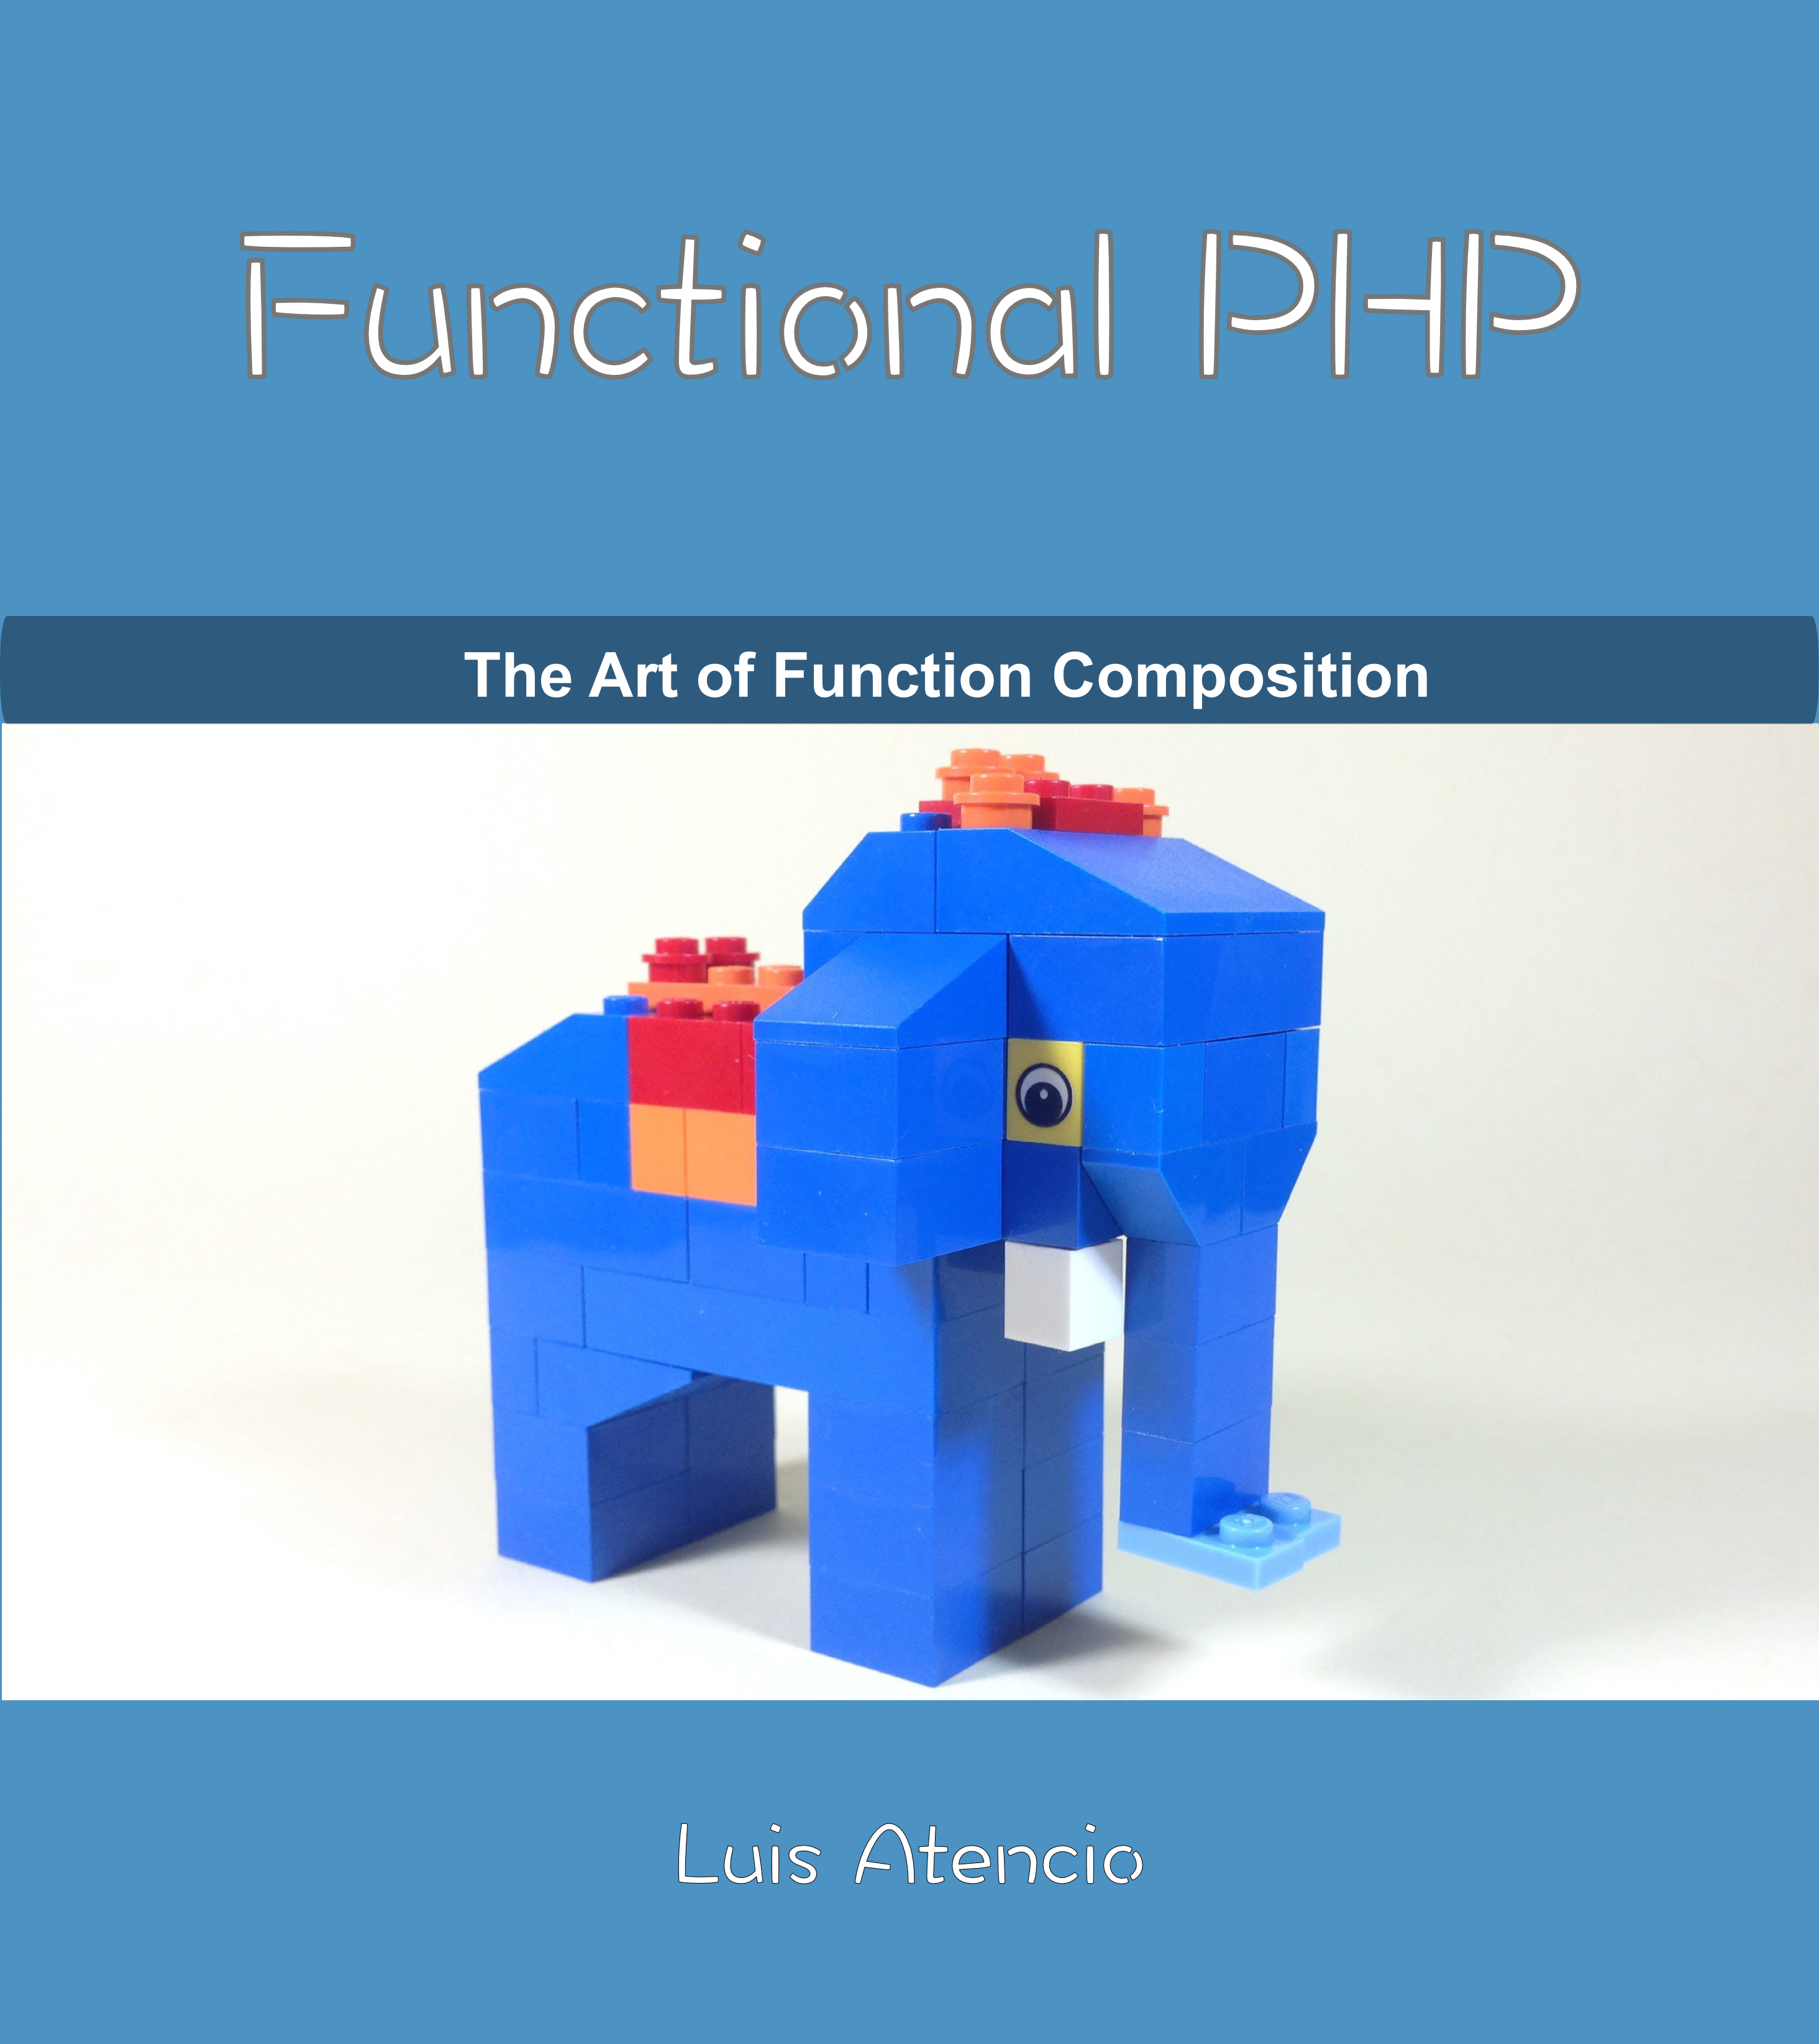
Functional
PHP
Free!
http://bit.ly/functional-php-book

Slide 70
Functional
PHP7 Video
-50% discount code: VIDFPHP7
http://bit.ly/fp-php7

Slide 71
See you later in:
Meet your BFF – Building Backends for Frontends
@luijar
https://joind.in/talk/97d06

